Slide 1





People -Mobility as-a-Service
Meta-Mobility Solution Provider – (MaaS)
( An ISO 9001, ISO 45001 Certified Co.) Leading SME’s of India 2024- Dun & Bradstreet

Slide 2



Service Offering
People Mobility Solutions
End to End Employee Mobility Services
Project - Mobility Solutions
End to End Corporate Rental Solutions
Community Commute
Consulting & Advisory for People Mobility
Travel Management companies - solutions

Slide 3















Value Builders
Objective Growth
WTi has in its lineage some of the India’s most pioneering and workable business models introduced in the “People Mobility Solutions”.
What binds together every member of “WTi” is all inclusive growth. Today the company can boast of making some large entrepreneur’s in the field of People Mobility Services in the country. The company is shaped by value-based guiding principles that underpin every business decision.
Integrated Service Model
Operational & Financial Efficiency
Opportunity to focus on core business
Single Window Engagement
Sustainable
Robust
Frugal
Contribution in Environment Support

Slide 4



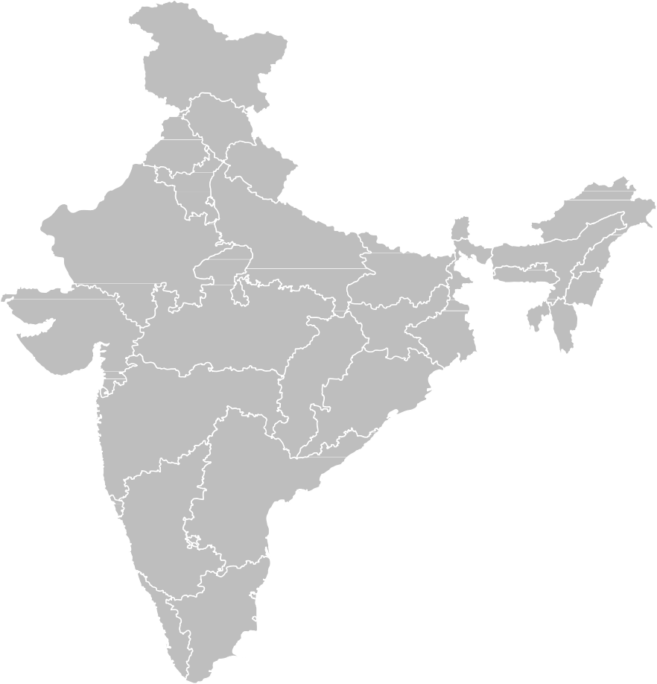

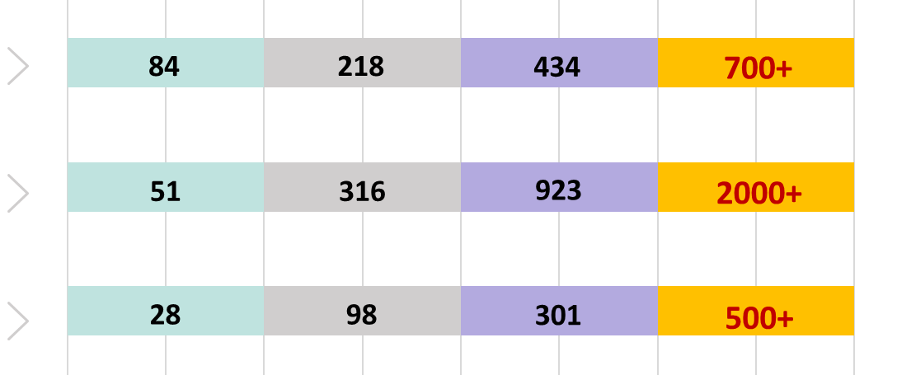






Pan-India Presence
We are one of the largest players in India, services all people transportation verticals
Our Capability Journey
2020-21
2021-22
2022-23
2023-24
Revenue (in Cr)
42
89
250
409
Team
251
372
521
847
Fleet
2031
3386
4963
7832
Operating in 29 States With 12 Regional Offices
Presence Through 200+ Locations
Airport Counters (Amritsar, Bangalore, Bhopal, Gwalior Guwahati, Jabalpur, Jaipur,
4
Madurai, New Delhi, Raipur, Rajahmundry, Varanasi, Visakhapatnam)

Slide 5
Sustainability

Slide 6













Society First
Planting 1,25,000 trees during the
current financial year
15 MILLION+
Clean kms Travelled
7%
Task entrusted to 136 Inf Bn (TA)ECO, MAHAR
ELECTRIC VEHICLES
–Induction plan
WTi currently deploys and manages a fleet of 7000+ vehicles. During the current fiscal we will replace 7% of ICE fleet with EV’s next year the number will double and in 5 years time we will run completely on EV’s
400,000+
Electric rides completed
Installing Solar Panels and generating power for self sustenance
1000+
Tonnes of CO2
emissions curbed
Reduce dependence on Fossil Fuels & Building an Eco-System to Supercharge EV Growth

Slide 7
Safety and Compliances
Vehicle Compliance
Awareness about safety and HSSE rule to all Stakeholder
Tools for safety assurance(like IVMS, Dashcam, temp-based fire extinguisher)
Chauffeur Compliance
Caliber and control mechanism for HSSE implementation
Training and reinforcement
Statutory Obligations
Incidence prevention management
Continuous improvement
Client based specific Compliance
Customized improvisation
Corrective actions based on historical data

Slide 8
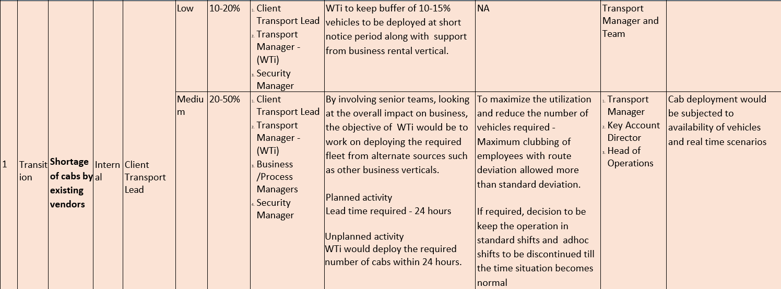
Business Continuity Plan

Slide 9
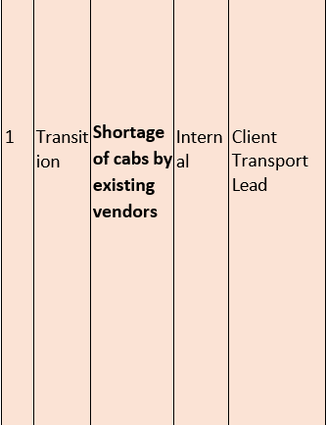
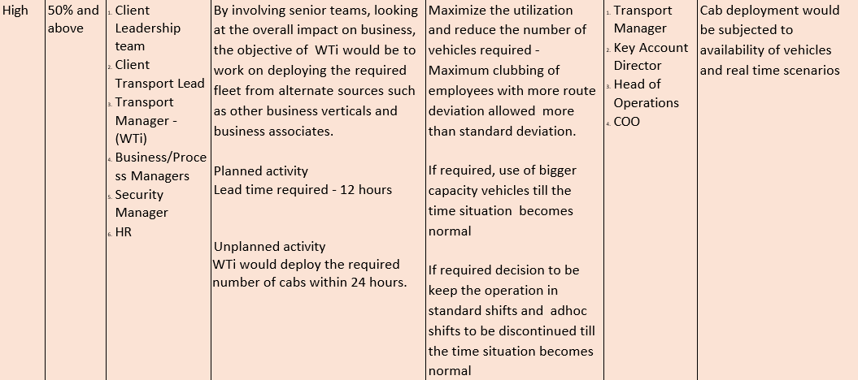

Slide 10
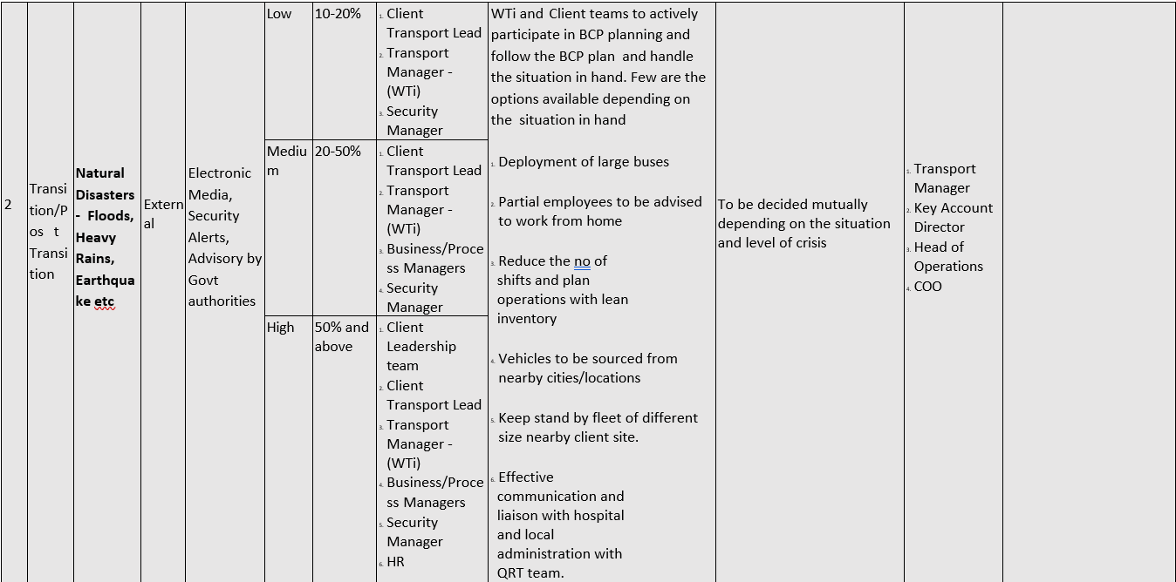

Slide 11
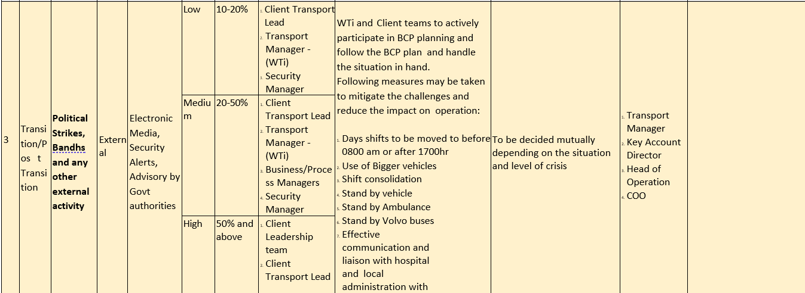


Slide 12
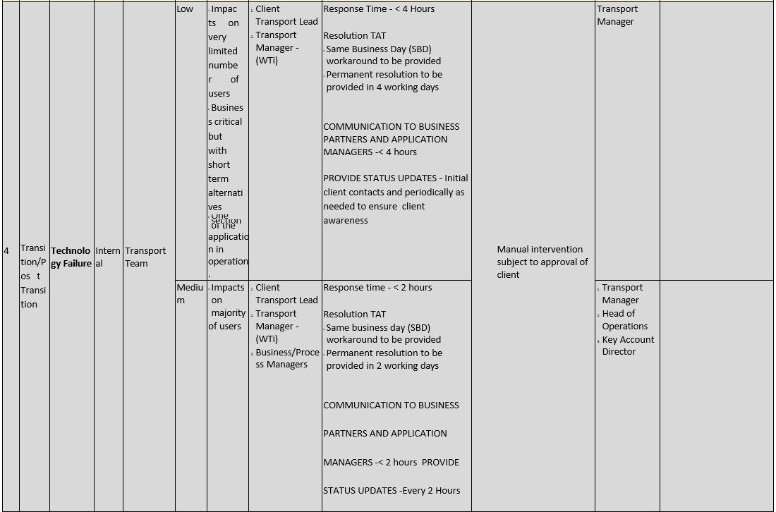

Slide 13
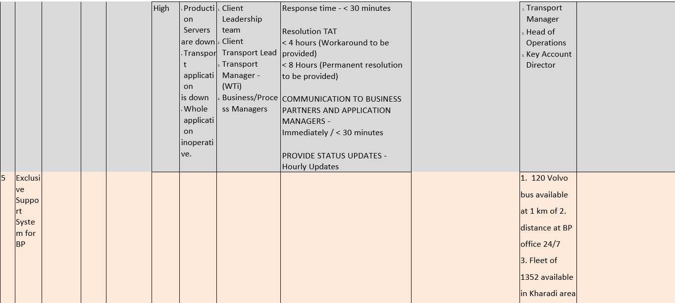

Slide 14
Account Management & operational excellence Model
Performance Metrics to be used for operational excellence.
As per SOW and SLA.
Complete mapping of service delivery system
Meeting qualitative & quantitative essence of contract
Response Time
Financial Performance
Crisis Management: Preparation & submission of Contingency Plan with the client, for the client, post transition for each site.
Realtime CSAT monitoring for immediate correction
Continuous Improvement:
Feedback
Sub-process re-engineering
Process engineering
Continuous Upgradation of SOP
Supply Chain Management & Inventory Control: Supply should be up by 10 to 15 % to take up demand for Variance Management. Supply should always be more than demand for Variance Management.
Business Associates Relationship Management: By formal: Monthly meeting, Training, Briefing and Continuous upgradation program and informal ways: Organizing lunch and Outing.
Robust Payment Models ( Max. 30 Days)
Independent Customer Success Team for floor connect
BCP Planning:
Continuous risk-assessment process
Anticipation of employee responsible for BCP for each site, clearly defining their KRA's, reporting pattern to client and development of SOP.
Corporate Governance & Account Management Model:
Being a Public Limited Company, Governance policy is defined at corporate level till the Account Management Level.
We have various part of committee i.e.. Audit Committee, Nomination & remuneration Committee, and Stakeholders Relationship Committee
Involvement of central leadership of WTi for setting up team to ethical conduct and accountability.
Percolation of Ethical principles and value to the lowest level.
Maintaining integrity and trust
Transparency & Accountability:
Financial Reporting including Gliding Cost Model
Contract management
Structured Reporting System to Client
Client communication
Risk Management
Identification of potential risk
Customized Strategy to mitigate such risk at each site level.
Transition Risk
Development and implementation of strategies to mitigate consultation with client.
Compliance
State / Local
National
Client Exclusive
overall risk in
Reporting & Analytics

Slide 15
Customer Protection - Tools

Slide 16







Customer Protection - Tools
Commercial General Liability Insurance (USD 1 Million)
Professional Liability
/ Error & Omission Insurance (USD 1 Million)
Cyber Security Insurance
(USD 1.25 Million)
Coverages and Liabilities
Crime Coverage Insurance (USD 1 Million)
Employer Liability Insurance (USD 1 Million)

Slide 17
Our Journey with British Petroleum

Slide 18
Our Journey with BP – 3 Years
Service Available | PAN India
Service | 24/7
Fleet Size | 212
Compliance | 100%
Driver | 220
Safety Tool | IVMS, Dash Cam / ECS / R.C
OTA | 97% +
OTD | 99.40%
Total no. of Accidents in 3 years | 53 (Minor)
Accidental Injury | NIL
User Rating (On scale of 5) | 1.) Driver - 4.86 2.) Car - 4.86 3.) Safety - 4.87 4.) Routing - 4.87 5.) Overall - 4.85
Carbon Reduction | 82 Metric Ton
Training | a) Defensive Driving, Traffic rules training , Monsoon Driving , HSSE Training including reporting system, Handling of road – rage , soft skill , POSH , Medical situation handling , BCP b) 6 R&R Program during 36 month
Achievement | a) Provided services at PAN India level b) Handled entire covid era successfully c) Supported and handled 19 BCP in 36 months d) Managed various events including annual day function successfully e) 759000 employees safely transported in 36 months without any injury or fatal accident f) No shortage of fleet in unpredictable and dynamic demand g) Uninterrupted service without influence of local factor h) Transported – Medical cases

Slide 19
Road Accident Statistic
India Vehicle Registration | 1% of Global Registration Fleet
Accident Rate | 6% of total accident in world
Reported Road Accident Data
Year | India |  | Pune |  | BP
 | Accident | Death | Accident | Death | Accident | Injury
2022 | 4,61,312 | 1,68,491 | 871 | 325 | 18 | 0
2023 | 5,83,264 | 1,98,378 | 1,025 | 425 | 16 | 0
2024 (upto May 2024) | 2,13,621 | 99,235 | 1,183 | 396 | 14 | 0

Slide 20



Temperature based auto activation inside bonnet in case of short – circuit or any other fire.
No risk of getting near fire for blowing out.
24 hours Auto protection
20

Slide 21
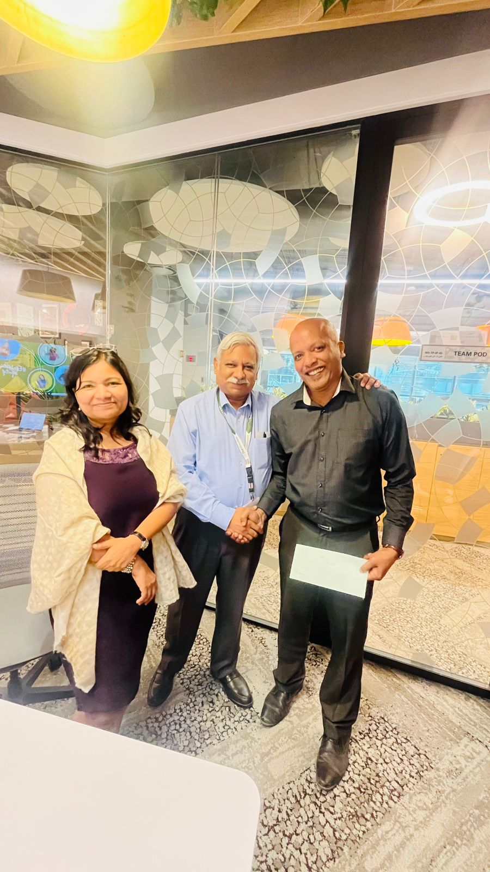
Achievement at BP in 36 Months
Recognized by Anand RV
& Kamna Prasad for Good Services
a) Provided services at PAN India level
b) Handled entire covid era successfully
c) Supported and handled 19 BCP in 36 months
d) Managed various events including annual day function successfully
e) 759000 employees safely transported in 36 months without any injury or fatal accident
f) No shortage of fleet in unpredictable and dynamic demand
g) Uninterrupted service without influence of local factor

Slide 22

What We Bring For BP
Safety First, On Time Delivery Must

Slide 23

OUR APPROACH
Protection of service delivery
System by adequate insurances
6
5
7
Importance of Safety and Compliance
Transition/ process reinforcement in first 60 days.
4
Adequate Supply Chain Management
8
BCP Planning & Execution
3
9
Percolation of contractual obligation up to last strata
Corrective actions of User Feedback
Engagement Principles
Clarity on Governance model & structured reporting system
2
10
High CSAT
Stakeholder Management:
Integrating common/ critical views on one platform for service delivery system. Bottom line driver/Vendor up to Client all connect
1
11
Billing & MIS

Slide 24
Engagement Model - Approach
Leadership
Maintain alignment across stakeholders to
Enable overall Client goals
Meets Quarterly
Three-tier engagement model :
Leadership
Senior Management
Service Delivery Executor
Senior Management
Guide Transport CoE business priorities or
Needs
Meets Monthly
Escalation Path
Strategic Direction
Service Delivery Executor
Manage the performance and priorities of
Service delivery and enhancements
Meets Daily/Weekly

Slide 25

PART 1
HSSE (Culture & Each Person Contribution ) (ISO 9001,14001 & 45001 Certified)

Slide 26
HSSE Culture
Shared values, beliefs and practices on safety, security and environment
Essential part of Employment & Business Associates
Collective Commitment towards HSSE for everyday operations and each activity
Two way communication model top to bottom and bottom to top
Audit & Continuous improvement
Tools for HSSE Culture Reinforcement
Leadership commitment
Visible & Defined HSSE goals /objective
Well define classified document HSSE policy integration with all core & non core business activities as part of behavior
Personal review & update
To ensure entire organization is engaged in promotion & support of safety program
Structured Escalation Matrix
Monitor Evaluation
Employee/B.A Empowerment
Adequate Resources allocation including, training & funds for safety tools
Safety Audit
HSSE Committee
Internal and External Communication
Incidence RCA & incorporation of Correlative steps in SUP
Role Model
Feedback pipe
In person meeting
Audio-visual
message / newsletter/social media broadcast Expert Webinar
Internal B.A group training
HSSE data analysis for .. Performance metrices
R&R programmer

Slide 27
Contribution of Each Person in HSSE
1. Leadership
2. Manager
3. Employee
4. Business Associate
5. Driver
Responsible for setting vision for HSSE.
Allocation of Resources Budget
Modeling the Behavior.
HSSE policy integration evolution(audit) in all aspect of company activities.
Facilitating open communication & reporting on HSSE matter without fear of retaliation.
R&R program for all connect as engagement model.
On ground implementation
Regular Audit
Team Training on HSSE Procedure.
Reporting of anticipated Safety concern for addressing solution.
Documentation and incidence recording.
To follow HSSE Procedure.
Active Participation in Training.
Reporting any unsafe condition .
Record Keeping and interaction with department in HSSE matter.
Onboarding post audit process.
Integration into HSSE culture
Compulsory training participation in HSSE training program
Participation in Evaluation
Willingness to accept reinforcement session.
Follow driving law (within city & highway)
Regular Checking & Reporting about Safety tools Kit in car.
Checking of vehicle health condition and scheduled maintenance at authorized service center.
Reporting all incidence of real time.
To follow vehicle maintain ace scheme.
Attending All HSSE Training.

Slide 28
MOM
Meeting Details:
Date : 16th August 2024
Time : 14:30 hrs – 15:45 hrs
Location : Central Office Delhi & VC
Attendees : CEO, Business COO, City Managers, HSSE & Compliance Head
2. Agenda:
Agenda : Prevention of Fire in moving vehicle
3. Discussion Points:
Agenda:
Discussion:
Overview of current safety practices
Use of advanced safety tools to extinguish fire in moving fleet
Actions:
Action 1: Explore temperature based auto activation of fire extinguisher and appropriate placement in the car for installation of same.
Decisions: HSSE Head along with his team will explore alternate options within 60 days of the meeting and post pilot lot testing and approval, will get it installed in vehicles across the country.
4. Review of Previous Actions:
Action Item 1: Monsoon Driving training to drivers across the country
Status: Completed
5. Next Meeting:
Date: 13th December 2024
Time: 15:30 hrs – 16:45 hrs
Location: Bangalore

Slide 29
HSSE Committee Structure
HSSE Committee
CEO (Chair Person)
ALL Business Head
(COO)
HSSE
(Head)
Key Account Director
(ops implementation)
Chief People Officer
CRO
CFI

Slide 30
PART 2
ORGANIZATIONAL & DELIVERY CAPABILITY

Slide 31
Existing BP Structure (Expansion scope available)
CLIENT
Key Account Director(20+ MBA or equivalent)
HSSE Officer (6-8 years experience)
Manager - User relations
Site Lead(15+yrs/ Graduate)
Shift Incharge (7-9 years Graduate)
Shift Incharge (7-9 years Graduate)
Shift Incharge (7-9 years Graduate)
Shift Incharge (7-9 years Graduate)
MIS and Data Analyst (5-7 years Graduate)
Tracker/ Deployer - 2 (Intermediate 5-7 years)
Router
Tracker/ Deployer – 2 (Intermediate 5-7 years)
Router
Tracker/ Deployer - 2 (Intermediate 5-7 years)
Router
Tracker/ Deployer - 2 (Intermediate 5-7 years)
Router
Continuous Resource Supply System to meet BP Expectation
GMT program for future leader
Training to other resources as backup
Headhunting for similar kind of resource
HR Recruitment as continuous process

Slide 32
Onboarding Process
Requirement for Manpower
Manpower Recruitment
Schedule
Identification of sources for recruitment
Screening & Forwarding of Resumes by HR to Business Head
Business Head shortlists resumes and return to HR to call for interview
Job Descriptions
Issue Offer letter
Salary Fixation
1st /2nd /Final Round
Psychometric Test
Approval for appointment
Reference Check
Interview Schedule
Off boarding Process
Ready to Continue
Submission of Resignation
Review of Resignation
Continue
Acceptance of Resignation
Conducting Exit Interview
Handing over formalities
Not Ready to Continue
Forwarding for acceptance of Resignation
Submission of No Dues Form
Attrition Rate: 1.97 % Yearly
De-activating the name
Of employee
Payment/ Recovery of Full Final Settlement
Prepare full & final Settlement
Exit of Employee
Issue of Relieving Letter

Slide 33
The selection process for the WTi - Graduate Management Trainee program
1) Eligibility Check
Applicants must have a Bachelor's degree from a recognized university (any stream).
Be less than 24 years old as of June 1st, 2024 (assuming the information is for the August 5th, 2024 program; adjust for future programs).
Meet all other requirements listed in the job description (communication skills, teamwork, etc.).
Online Application: Submit an updated resume through the provided Google Form link.
2) Selection Stages
Online Assessment HR Talk Screening Round Group Discussion Panel Interview
3) Selection Notification
Following the selection process, candidates will be notified of the outcome via email.
Once the candidate is notified they have to submit PAN, Aadhar, Bank Account details, class X, XII & Graduation certificate along with Reference
The documents are verified and then the letter of Offer is issue to GMTs.
All GMTs are scheduled to join on a specific day as decided by the Organisation

Slide 34
4) Mapping of KRA
5) Joining & Induction
Travel and accommodation will be provided for a 3-day orientation at the company headquarters for shortlisted candidates.
The program emphasizes continuous learning through rotations across core departments (Operations, Sales & Marketing, Customer Success), deep dives into specialized areas, and collaborative projects for 12 months
By successfully completing the program, graduates receive a pre-placement offer within WTi Cabs.
Supply Chain Management for backfilling of resource
Collection & Creation of Databank for manpower
GMT Programme
Continuous Head Hunting to create buffer pool of manpower
Source : Job Portals, References, Head Hunting, Social media like linked in

Slide 35
PART 3
RELEVANT EXPERIENCE
Pioneer in End to End Mobility Solution

Slide 36
List of Current Clients
HSBC
Location: Pune, Bangalore, Kolkata, Gurugram
Contract Duration: Approx. 7 Years
Contract Scope: Management of Employee Transportation Services (End to End)
Total Contract Amount: 50 Cr per annum
UBS
Location: Pune & Mumbai
Contract Duration: Approx. 4.5 Years
Contract Scope: Management of Employee Transportation Services (End to End)
Total Contract Amount: 38 Cr per annum
British Petroleum
Location: Pune
Contract Duration: Approx. 3 Years
Contract Scope: Management of Employee Transportation Services(End to End)
Total Contract Amount: 18 Cr per annum approx.
First Source
Location: Bangalore
Contract Duration: Approx. 6Years
Contract Scope: Management of Employee Transportation Services (End to End)
Total Contract Amount: 26 Cr per annum
List of Previous Clients
Citi Bank
Location: PAN India including Pune
Tesco
Location: Pune & Bangalore
Contract Duration: Approx. 6 Years
Contract Scope: Management of Employee Transportation Services
Total Contract Amount: 47 Cr per annum
Contract Duration: Approx. 4 Years
Contract Scope: Management of Employee Transportation Services
Total Contract Amount: 22 Cr per annum

Slide 37
Case Study 1 – BFSI
Objective | Before | After
Sites Managed | NA | Delhi, Mumbai, Pune, Kolkata, Bangalore
User count | NA | 9000 +
OTA/OTD | 80%/85% | 98%/99%
Occupancy | 40-45% | 70-85%
Compliance | NA | 100%
Technology | Manual operations | Implemented end to end technology covering all aspects of operations, i.e. employee registration, rostering, routing, allocation, dispatch, , GPS tracking, compliance, billing, SMS alerts, MIS, IVR, Mobile app for employees and drivers
Objective | Before | After
MIS, Reviews & Reporting | No structured reviews/Reporting | MIS, Dashboard shared and weekly, Fortnightly, Monthly reviews with Client Teams
Cost optimization | Not Applicable | 6-8%
Safety Issues | 1.97% | 0.0025%
CSAT | Not Measured | 4.73/ 5
Female Safe Home Reach | Not Measured | 100%
No Show | 0.096 | 0.0263
Escort Trip Reduction | Not Measured | Reduced by 4.87%
Central Helpdesk System 24/7 | Not Available | Created and made it core of support system to the user.
QRT | Not Available | Deployed for 24/7

Slide 38
Case Study 2 – Large IT Company
Objective | Before | After
Sites Managed | NA | Hydrabad, NCR
User count | NA | 3600 +
Hybrid Working (Two Days) | NA | 100% Complied Fleet Available
Management of Spike in request | NA | Mixed operating model – Fixed package and trip model implementation
Adequate Supply of Fleet | NA | Waiting Line “Q” Model Implemented in Supply Chain Management
Objective | Before | After
Compliance | NA | 100%
Technology | Manual operations | Implemented end to end technology covering all aspects of operations, i.e. employee registration, rostering, routing, allocation, dispatch, , GPS tracking, compliance, billing, SMS alerts, MIS, IVR, Mobile app for employees and drivers
QRT | Not Available | Deployed for 24/7
Central Helpdesk System 24/7 | Not Available | Created and made it core of support system to the user.
CSAT | Not Available | 4.8/5

Slide 39
Case Study 3 – BP
Challenges | Solution
4.) Specific Safety Compliance | Installation of Dash Cam / IVMR in car. Contributed & Connected all IVMR with BP central command center. Zero injury in accident Accident/Incident rate- 0.020%
5.) Management of on Time Service Delivery :- a) Geographical Challenges b) Social Political Challenges – Local nuisance c) Social Procession like Protest for Maratha Reservation d) Religious Procession like Ganesh Chaturthi & Palki | a) Traffic trend study at various login time to decide and implement user wise ETA for pickup to keep OTA at 97% minimum. b) Using various methodology for solution like Persuasion, Political Influence, Back Channel Diplomacy ,certain CSR work in locality Personal Reputation building, Local engagement to ensure flawless service and no local hindrance into BP System. (c & d) Study of Government G.O & Police Advisory Route Mapping Liaison with Local Authority Driver Briefing Arrangement of buffer and connecting fleet QRT deployment
Challenges | Solution
1. ) Started from Scratch | Minute and Micro Planning for setting up transport desk, manpower arrangement, fleet arrangement with highest safety standards including COVID -19 Government guideline.
2.) Covid – 19 | No induction of driver without vaccination. Partition in car with all advised stuff like mask/sanitizer During Covid required Inova fleet was not available in market . However, we arranged Crysta on fair rate to support the operation. Standby cars without sufficient business during COVID.
3.) Exclusive category of fleet & unpredictable demand | Allocation of dedicated fleet to BP in trip based operation model. Exclusive category of fleet was hired on dedicated model irrespective of business volume. Covering high risk of loss but treated it as investment in relationship.

Slide 40
PART 4
ORGANISATION STRENGTH

Slide 41
Fleet & Manpower
Question | Answer
Total Number of in-house staff assigned to BP | 20 & further as per business requirement
2. Total Number of own fleet | 20% of progressive demand & all EVs
3. Total Number of leased fleet | 60% of progressive demand
4. Total Number of outsourced dedicated fleet (to operate on trip model) | 20% of progressive demand

Slide 42
PART 5
TOOLS & PROCESS LINKED WITH BUSINESS STAGES

Slide 43
Lists of the Tool for tracking compliance at different Business stages
Induction:
Pre-onboarding - Business Associates HSSE Assessment
Fleet maintenance record tracking with service station.
Physical checking of all documents
VAP/DASP
Post Induction:
Moveinsync with pre-expiry alert system.
Physical pre journey check for Hardware of Dash cam & IVMS
Command center for functioning of IVMS
Steps for Continuous Improvement
Historical data analysis
Route optimization
Dynamic supply chain management for buffer resources including fleet
Strategic tie up with vehicle manufacturer for quick delivery and priority service.
R&D on new safety equipment for fleet

Slide 44
Market Information Sharing with Clients
Sharing Market intelligence through personalize communication
Social Media Updates
Monthly Management review meeting
R & R Programs
Feedback Circuit

Slide 45


Indicative Management Reports
User registration Reports:
Compliance Reports ( All compliance including Escort )
Monthly User Reports
Employee Schedules Reports
Geofencing Reports
Roster Reports / Trip Reports
Distance Reports
Category of Vehicle Deployed Reports:
Vehicle Status Reports
EV utilization Reports
Carbon Footprint Saving Reports
Vehicle Breakdown Report
OTA / OTD Report
Occupancy Report
No show Report / Business Line wise
Escort Trip Reports
ShiftWise Trip Reports
Safety & Security Reports:
SMS Reports
Tracking Reports
SOS Reports
Safe Reach Home Reports
Female Trip Reports
Special need user Report
Speed violation Report
Incidence Report
Technical Bugs Report
Downtime Reports
Schedule & Maintenance Report
Daily Minor Technical Issues
Feedback Analysis & Corrective Actions if any
Compliance Report, Analysis and Essential Corrective Actions
Customer Satisfaction Index
Billings & Audit Reports:
Billing Reports
SLA Score card
Technical Reports:.
Feedback Reports:

Slide 46

















Indicative Clients
17
17

Slide 47




18
THANK YOU

